Slide 1
Hierarchical Task Analysis (HTA)

Slide 2
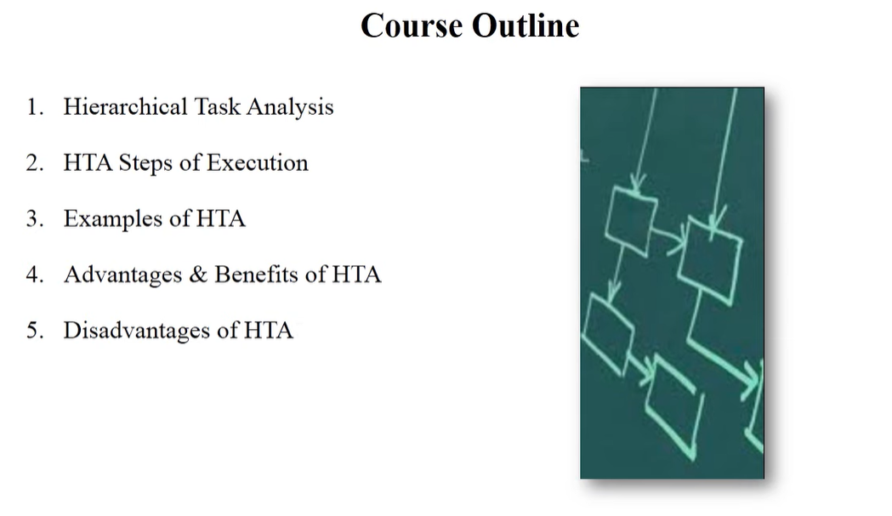

Slide 3
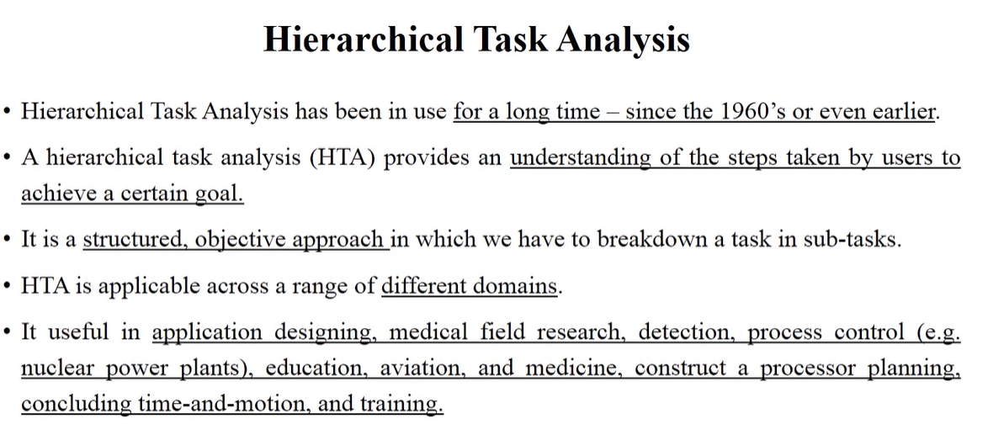

Slide 4
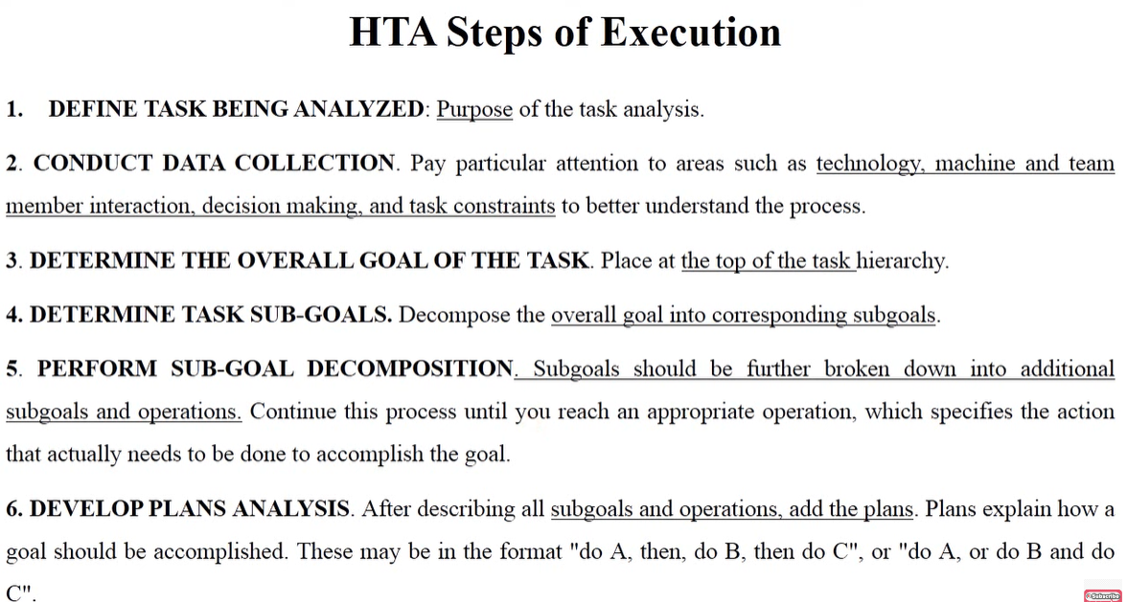

Slide 5
Steps of Execution
Hierarchical Task Analysis (HTA) is a structured method for analyzing tasks by breaking them down into subtasks, goals, and plans. Here's an explanation of the six steps of execution:
1. Define Task Being Analyzed
Identify the task that needs to be analyzed.
Understand the purpose of the task analysis and why it is being performed.
This step sets the foundation for breaking down the task effectively.
2. Conduct Data Collection
Gather relevant information about the task.
Consider factors such as technology, machine and team member interaction, decision-making, and task constraints to gain a deeper understanding.
Observations, interviews, and document analysis may be used.

Slide 6
Steps of Execution
3. Determine the Overall Goal of the Task
Clearly define the ultimate objective of the task.
Place this goal at the top of the task hierarchy as a starting point.
4. Determine Task Sub-Goals
Break down the overall goal into smaller, manageable sub-goals.
Each sub-goal represents a critical step toward achieving the main goal.
5. Perform Sub-Goal Decomposition
Further decompose sub-goals into smaller sub-goals or specific operations.
Continue breaking down the task until you reach the lowest level of operations (specific actions needed to complete the task).
This helps in understanding the detailed steps required to achieve each sub-goal.

Slide 7
Steps of Execution
6. Develop Plans Analysis
Once all sub-goals and operations are defined, create plans to describe how they should be executed.
Plans specify the sequence and conditions for completing tasks.
Example formats include:
"Do A, then do B, then do C" (sequential steps)
"Do A, or do B and do C" (parallel or conditional actions)
HTA is widely used in human factors, user experience (UX) research, and process optimization to improve workflows, training, and system efficiency.

Slide 8
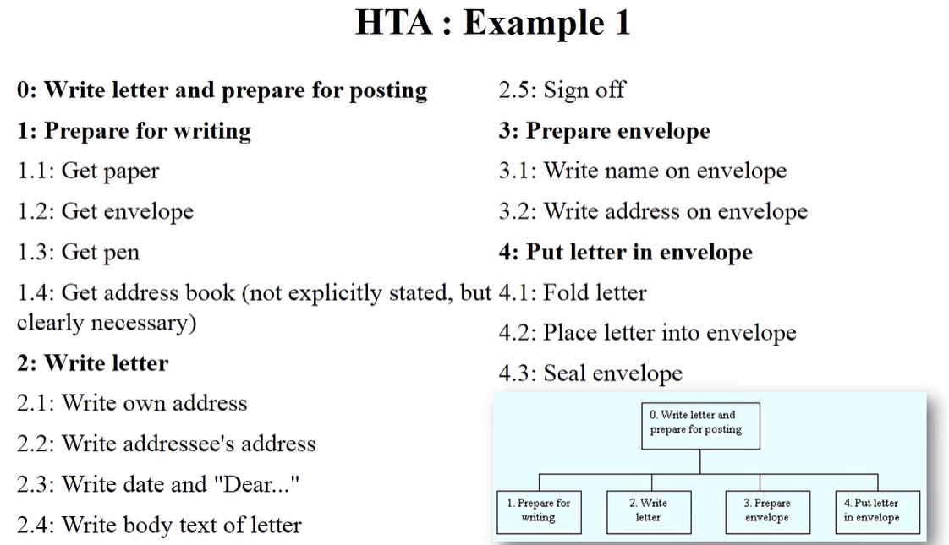

Slide 9
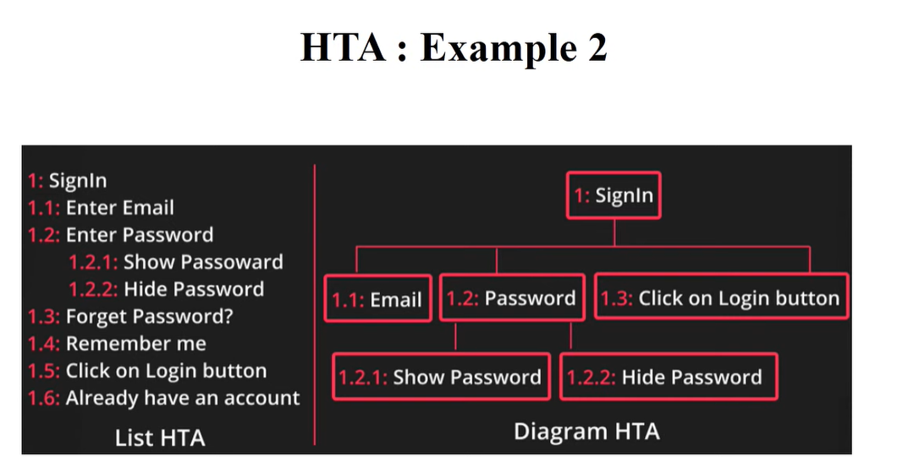

Slide 10
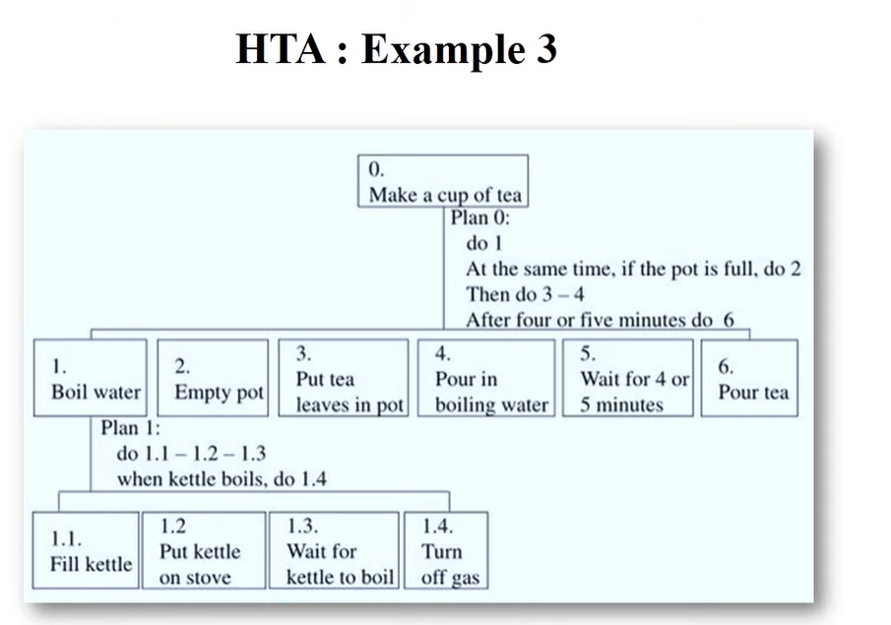

Slide 11
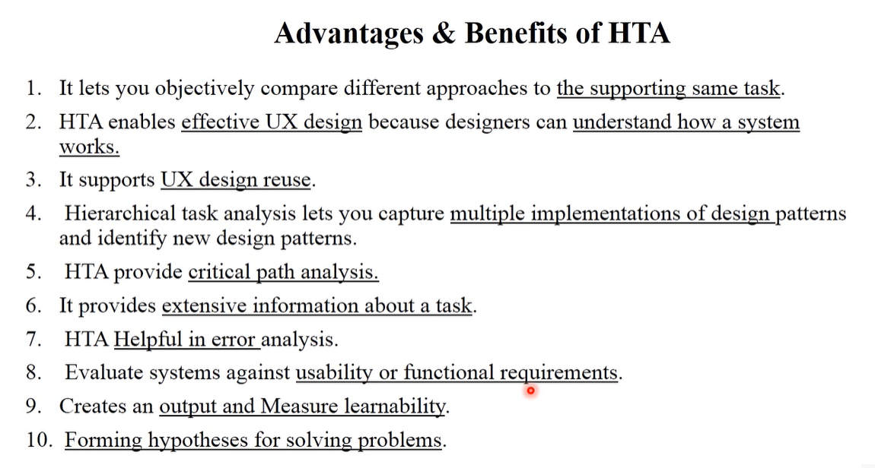

Slide 12
